Slide 1

Feature Based MT Evaluation
IASNLP-2022, IIIT-Hyderabad

Slide 2
HELLO!
TEAM - 2
SHUBHAM VARMA
SUMAN SAURABH
MENTOR:
Ananya Mukherjee

Slide 3
OVERVIEW
PROBLEM STATEMENT
ROADMAP
ANALYSIS OF DATA
EXPERIMENTED MODELS AND RESULTS
ANALYSIS OF PERFORMANCE
CONCLUSION
FUTURE WORK
REFERENCE

Slide 4
Practical Experience says nobody wants to improve without evaluation and this applies same with Machine Translation models.

Slide 5
PROBLEM STATEMENT:
There are several evaluation metrics which compute the final translation score by computing individual feature scores (lexical, morphological, synonym similarity (word level) and sentence semantics similarity). We have to train our model such that optimal weights are learned for these linguistic features, resulting in having high correlation with human.

Slide 6
ROADMAP
A strategic overview of the major elements of our project

Slide 7
Roadmap
Understanding Problem
Feature Evaluation
Evaluating results
1
3
5
2
4
6
Rating Sentences in Dataset
Training and Tuning Models
Analysis of Results

Slide 8
FLOWCHART

Slide 9

Flowchart
Test Data (500 Translated Sentences)
Manual Rating
Dataset Prepared for Testing
Training Dataset
COMET Model to generate ratings
(100000)
Training Different Models
Testing Models
SVR
ANN
DT
RFR
XGB
ADA
BiLSTM
0.25
0.61
0.16
0.13
0.482
0.61
0.54
Pearson correlation coefficient

Slide 10
ANALYSIS OF DATA

Slide 11
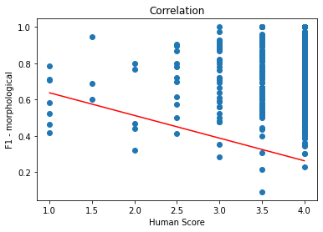
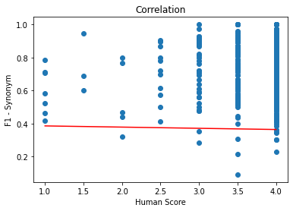
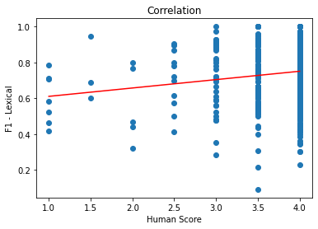
Analysis of Data(Training)
Morphological
Synonym
Lexical

Slide 12
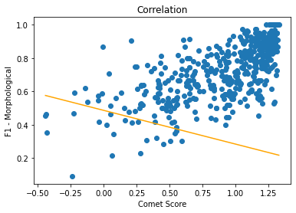


Analysis of Data (Training)
Morphological
Synonym
Lexical

Slide 13
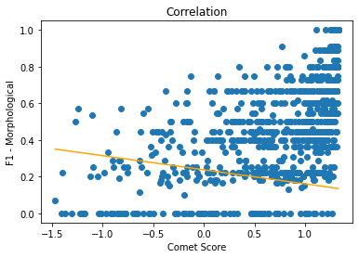

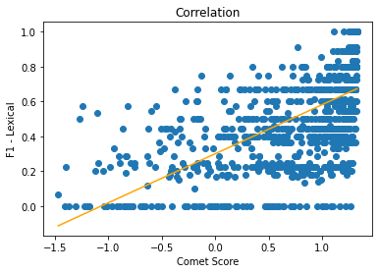
Analysis of Data (Testing)
Morphological
Synonym
Lexical

Slide 14
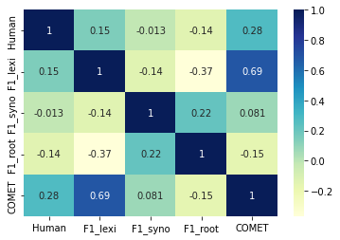
Analysis of Data
We can see there is maximum correlation of lexical matching with human score, obviously we understand the reason behind this maximum correlation, as if there are more common words between translated sentence and reference sentence there will higher chances of correct translation.
However there is poor correlation between morphological matching and human rating, reason behind this may be due to fewer cases where words with same root word are in difference morphological form.

Slide 15
Analysis of Data
However we also observed COMET score correlation with human score for sentences is only 0.28. Which also made us to think about the results which we may get on training with COMET score.

Slide 16
EXPERIMENTED MODELS AND RESULT ANALYSIS

Slide 17
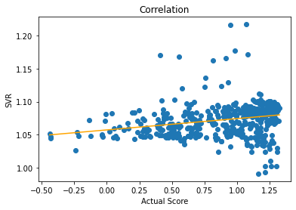
EXPERIMENTED MODELS AND RESULTS
SVR
kernel='rbf'
C= 1e3
gamma= 0.1
Rest all parameters are default parameters
After trying for different hyper parameters we got the best results of prediction with Pearson’ s Correlation Coefficient as 0.25

Slide 18
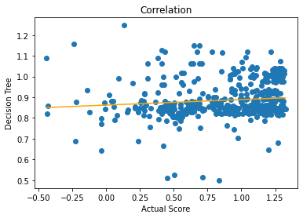
EXPERIMENTED MODELS AND RESULTS
2. Decision Tree
criterion='squared_error', splitter='best', max_depth=None, min_samples_split=2, min_samples_leaf=1,
Rest default parameter
Obtained Pearson’s correlation coefficient of 0.2

Slide 19
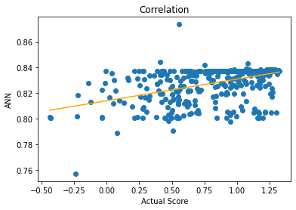
EXPERIMENTED MODELS AND RESULTS
3. ANN
4 Hidden Layer(Dense Layer)) with 300-300-100-56 nodes in each layer respectively
Optimizer = Adam
Loss Function: Mean Square Error
Batch Size: 30
MSE:0.3599
Obtained Pearson’s correlation coefficient of 0.55

Slide 20
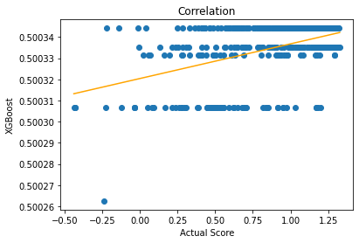
EXPERIMENTED
MODELS AND RESULTS
4. XGBoost
Parameters:
Objective: reg:linear
random_state = 0
learning_rate = 0.001
N_estimator = 100
Other are constant
Pearson Correlation coefficient = 0.482

Slide 21
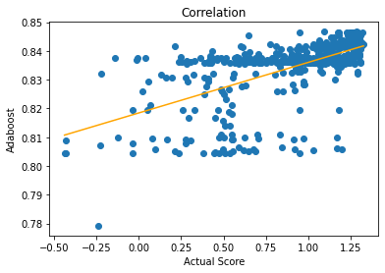
EXPERIMENTED MODELS AND RESULTS
5. AdaBoost
Hyper Parameters:
random_state = 0
n_estimator = 100
Learning_rate = 0.001
loss = linear
Other are constant
Pearson Correlation coefficient = 0.612

Slide 22

EXPERIMENTED MODELS AND RESULTS
6. Random Forest
Hyper parameters
n_estimators=150
random_seed = 42
criterion='squared_error'
Rest of all the parameters were default.
We tried with different number of estimators like 50,100,150,200,250 but the best result we get on n_estimators = 100 with Pearson Correlation coefficient = 0.15

Slide 23
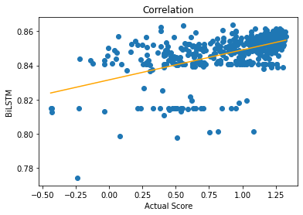
EXPERIMENTED MODELS AND RESULTS
7. BiLSTM
Hyperparameters:
Two Bi-Directional LSTM Layers with number of nodes: 64-20
Dropout: 0.5
Optimizer : rmsprop
Loss Function: Mean Square Error
batch_size=30

Slide 24
Analysis of Performance of Models:
If we observe the results, simple machine learning models have shown poor performance like decision tree, Support vector regression and random forest regressor have low Pearson correlation coefficient like 0.15,0.25,0.16. However with random forest we tried to improve its performance by changing the number of estimators but still we are not able to achieve very good performance.
While other ensemble machine learning model like XgBoost, AdaBoost have performed well and shown correlation coefficient of 0.48,0.61 respectively .Ada Boost has outperformed all ML Models, this shows that the function which models are trying to learn is much complex.This may be the reason of poor performance of simple ML models.

Slide 25
Analysis of Performance of Models:
Deep Learning model with multiple dense layers are performing good with PCC of 0.61 for Neural network with 4 dense layers and 0.55 for BiLSTM layers however BiLSTM have not performed better than ANN because there is no sequence data involved in training where preservation of context is important.

Slide 26
Conclusion
Our Dataset is of complex nature however there are only 3 features but still to find the best model which can give maximum pearson correlation coefficient value with human rating we tried 7 different models.
Lexical features are most correlated with human rating and COMET score while morphological feature is showing very poor correlation with Human and COMET score.
Deep Learning models are performing better than Machine learning models, with their dense architecture we are able to capture the hidden pattern in data and the predicted score are better correlated with human rating.

Slide 27
Future Work
While evaluating features and evaluating F1 scores, we observed there may be some cases where if reference sentence consist of many words and the other translated sentence have few words,cases may arise where after doing lexical matching, Morphological matching,Semantic matching, many few words may remain unmatched which may indicate poor translation.
Therefore we can introduce penalty feature in our metric while evaluating matching and evaluating features value(especially for free word language families), which will definitely improve the model.

Slide 28
Reference:
https://machinelearningmastery.com/adaboost-ensemble-in-python/
https://towardsdatascience.com/predictive-analysis-rnn-lstm-and-gru-to-predict-water-consumption-e6bb3c2b4b02
https://towardsdatascience.com/lstm-and-bidirectional-lstm-for-regression-4fddf910c655
https://towardsdatascience.com/predictive-analysis-rnn-lstm-and-gru-to-predict-water-consumption-e6bb3c2b4b02
https://towardsdatascience.com/understanding-adaboost-2f94f22d5bfe
https://www.mygreatlearning.com/blog/adaboost-algorithm/
https://www.analyticsvidhya.com/blog/2016/03/complete-guide-parameter-tuning-xgboost-with-codes-python/
https://www.analyticsvidhya.com/blog/2021/08/a-walk-through-of-regression-analysis-using-artificial-neural-networks-in-tensorflow/
https://machinelearningmastery.com/regression-tutorial-keras-deep-learning-library-python/
https://www.tensorflow.org/tutorials/keras/
https://www.tensorflow.org/text/guide/word_embeddings
https://www.tensorflow.org/text/guide/bert_preprocessing_guide
https://towardsdatascience.com/machine-learning-basics-decision-tree-regression-1d73ea003fda
https://towardsdatascience.com/how-to-tune-a-decision-tree-f03721801680
https://towardsdatascience.com/random-forest-hyperparameters-and-how-to-fine-tune-them-17aee785ee0d
https://www.analyticsvidhya.com/blog/2015/06/tuning-random-forest-model/
https://towardsdatascience.com/unlocking-the-true-power-of-support-vector-regression-847fd123a4a0#:~:text=Support%20Vector%20Regression%20is%20a,the%20maximum%20number%20of%20points.

Slide 29
THANKS!
Any questions?
You can find us at:
shubham.varma@somaiya.edu
suman_2111mc13@iitp.ac.in

